Slide 1

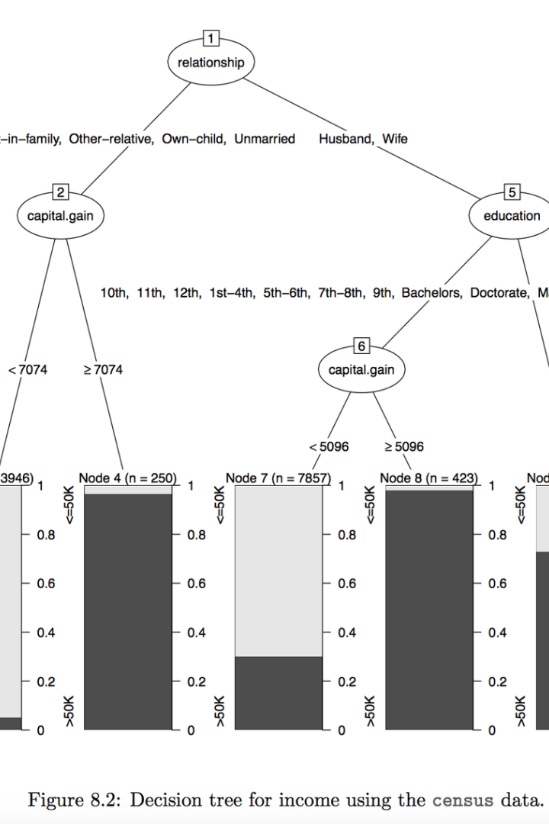
Introduction to Basic Libraries in Data Science
In the evolving landscape of data science, the importance of foundational tools cannot be overstated. Among these crucial tools are libraries that simplify the handling, analysis, and visualization of data. They serve as the bedrock upon which complex analytical tasks are performed, aiding novices and experts alike. This introductory section will shed light on three such pillars of data science: NumPy, pandas, and matplotlib.
NumPy, an acronym for Numerical Python, is the pre-eminent library for numerical computations in Python. It provides a flexible and powerful data structure, the N-dimensional array, that forms the basis for the majority of data manipulation tasks. It excels in performing complex mathematical operations with ease and efficiency, which is essential in the realm of large datasets.
Pandas stands as a quintessential tool for data wrangling and analysis. At its core is the DataFrame, a sophisticated data structure that mirrors a tabular format, reminiscent of SQL tables or Excel spreadsheets. Pandas endows its users with the ability to effortlessly import, clean, and explore datasets, bridging the gap between raw data and actionable insights.
Matplotlib is the cornerstone library for creating data visualizations in Python. Through its comprehensive collection of plotting functions, it facilitates the translation of data into graphical representations. With the ability to convey complex data narratives through charts and graphs, matplotlib empowers data scientists to weave stories that are as compelling as they are informative.
Ma
by Mvurya Mgala

Slide 2
What is NumPy?
Core Scientific Computing Library
Array Operations and Broadcasting
NumPy is an essential library in the Python programming language, primarily used for performing numerical computations. It offers an array object known as ndarray which is far superior to regular Python lists when it comes to handling large datasets efficiently, both in terms of speed and memory usage. NumPy's core contribution to scientific computing in Python cannot be understated, providing foundational support for a wide array of mathematical operations.
With NumPy, users can perform complex mathematical operations on arrays and matrices with ease. These operations include element-wise calculations, linear algebra, statistical analysis, and more. One of the most powerful features of NumPy is broadcasting, which allows for array operations on arrays of different sizes and shapes. Broadcasting simplifies code and improves performance, making it a highly appreciated feature among developers handling multidimensional data.
Integration with Other Libraries
Community and Open Source Development
NumPy seamlessly integrates with many other libraries in the Python data ecosystem, such as pandas for data manipulation, matplotlib for data visualization, and SciPy for additional scientific computing tasks. This interoperability makes NumPy a linchpin within the data science and machine learning communities, enabling practitioners to build sophisticated data workflows with relative ease. NumPy's widespread adoption is not only due to its capabilities but also to its role as a building block for many high-level specialized libraries.
The development of NumPy is a testament to the collaborative power of open source projects. It is maintained and improved by a large community of contributors, ranging from academic researchers to industry professionals. The community's efforts ensure that NumPy stays up-to-date with the latest computing techniques and remains compatible with the evolving Python language. The library's extensive documentation and active support forums further cement its position as an invaluable tool for developers worldwide.

Slide 3
Key Features of NumPy
Multidimensional Array Object: At the core of NumPy is the ndarray, allowing fast and versatile operations on large datasets. This efficient multi-dimensional container of homogeneous data types significantly surpasses native lists in both functionality and speed.
Broadcasting Capability: NumPy's broadcasting rule is a cornerstone, enabling arithmetic operations between arrays of different shapes as if they were compatible. This feature eliminates the need for explicit looping in many cases, resulting in concise and readable code.
Mathematical Functions: Providing a comprehensive suite of mathematical routines, NumPy allows for element-wise operations and advanced computations. Linear algebra, Fourier transform, and random number generation are just a few of the extensive capabilities included.
Integration with other Python Libraries: NumPy seamlessly integrates with a multitude of other scientific computing libraries such as pandas, SciPy, and Matplotlib. This interoperability is critical for facilitating complex data analysis and visualization tasks.
Memory Efficiency and Performance: Designed with memory optimization in mind, NumPy arrays use less memory than Python lists. Additionally, its functions are implemented in C, ensuring a performance that could be several magnitudes higher compared to pure Python code.

Slide 4

Array Creation and Manipulation with NumPy
1
Initial Array Creation
Creating arrays is a foundational aspect of using NumPy, a powerful library for numerical computing in Python. The beauty of NumPy is in its efficiency and simplicity when handling large datasets and complex mathematical operations. To begin, arrays can be created from Python lists using np.array(), or initialized with zeros or ones using np.zeros() and np.ones(). It’s also possible to generate sequences of numbers with np.arange(), ideal for creating evenly spaced values, which is widely used in data sampling and iteration processes.
More advanced creation functions include np.linspace(), which allows for the precise specification of the number of points, and np.logspace(), useful in creating logarithmically spaced numbers, beneficial in various scientific computing contexts. The power of NumPy's array creation sets the stage for efficient data manipulation and fosters the seamless execution of vectorized operations, thereby optimizing computational performance.
2
Manipulating Array Shapes and Sizes
Once arrays are created, NumPy enables their transformation in ways that facilitate data analysis tasks. Reshaping arrays with np.reshape() allows data to be organized for different operations, without altering the original data – a key feature for any data scientist or analyst undertaking exploratory data analysis. NumPy ensures that this restructuring is memory-efficient, as it does not produce a copy of the array, but rather a new view of the same data.
Another powerful feature is broadcasting, where NumPy allows operations on arrays of different shapes, enabling arithmetics on arrays that would otherwise be dimensionally mismatched. This adaptability is integral to machine learning algorithms that require large-scale computations. Through commands like np.expand_dims() or np.squeeze(), one can effectively manipulate the dimensions, facilitating compatibility between different data forms and preparing them for complex calculations.
3
Slicing, Indexing, and Iterating
NumPy’s slicing and indexing empower users to access and modify array elements with tremendous flexibility. Complex datasets can be navigated with slicing to isolate specific data points, which is indispensable for functions like feature selection and time-series analysis. The elegance of NumPy's slicing syntax simplifies the retrieval and updating of array subsets, which otherwise would be a daunting task with raw Python structures.
Iteration over arrays is another core functionality, as NumPy provides iterators such as np.nditer() that are optimized for multidimensional arrays, ensuring that even with large datasets, the memory consumption and computational load are minimized. This facilitates data transformations and more elaborate analyses, whether that be in scientific computing, where large volumetric data is prevalent, or in financial modeling, where speed and efficiency are paramount.

Slide 5
Mathematical Operations with NumPy Arrays
Basic Arithmetic Functions
Advanced Mathematical Methods
Universal Functions (ufuncs)
NumPy's core feature is its ability to perform element-wise arithmetic operations with ease. Users can execute addition, subtraction, multiplication, and division on arrays of any size without writing explicit loops. This leads to significant improvements in code readability and performance, especially when working with large datasets. Operations align according to the shape of the arrays, complying with broadcasting rules.
NumPy goes beyond basic arithmetic to include a host of mathematical functions that cater to more complex operations. It incorporates functions from linear algebra, such as matrix multiplication and eigenvalue decomposition, which are essential for high-level data analysis and modeling.
The true power of NumPy lies in universal functions, or ufuncs, which are optimized to work on ndarrays by performing element-by-element operations — a methodology that reduces loop overheads and speeds up computation. These functions not only apply to all elements of an array simultaneously but are also compiled in C to achieve maximum performance.
Additionally, statistical operations like mean, median, variance, and standard deviation can be computed with single function calls, streamlining the exploratory data analysis process. What truly sets NumPy apart is its ability to handle these calculations with stunning efficiency, thanks to optimised C-based algorithms under the hood.
Whether it's trigonometric, logarithmic, or comparison operations, universal functions maintain consistency in design and usage. By leveraging ufuncs, developers can ensure their analytical applications run at optimal speeds, handling large volumes of data with commendable precision and efficiency.
For instance, adding a scalar to an array increases every element by that scalar, while adding two arrays of the same shape performs the addition element-wise. This intuitive manipulation extends to more complicated operations like exponentiation and modular arithmetic, rendering NumPy an invaluable tool for mathematical computation.

Slide 6
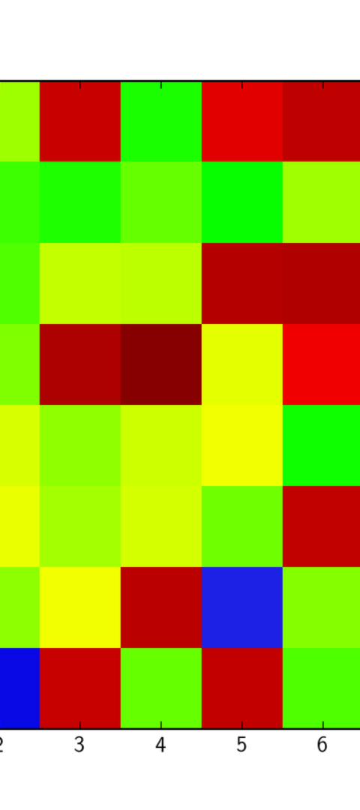
Indexing and Slicing in NumPy
Accessing Array Elements
Basic Slicing Techniques
Indexing in NumPy allows direct access to the array's elements. Just like in a list, indexing starts from zero. To access an element from a one-dimensional array, use the syntax array[index]. In multi-dimensional arrays, access elements by specifying a tuple of indices separated by commas. For instance, array[row_index, column_index]. NumPy's indexing feature is powerful, allowing for complex data extraction effortlessly.
Slicing in NumPy arrays borrows from Python's standard slicing syntax. Use the colon operator to indicate the start, end, and step of a slice: array[start:stop:step]. This allows for the selection of a range of elements and is similar to slicing lists or strings in Python. However, NumPy arrays take slicing to the next level with the ability to perform multi-dimensional slicing, which can be used to extract rows, columns, or sub-matrices from higher-dimensional arrays with ease.
Advanced Indexing Techniques
NumPy extends beyond basic indexing with advanced strategies like boolean indexing, fancy indexing, and the use of index arrays. These methods provide more nuanced selection capabilities. For example, boolean indexing allows for the selection of elements that meet certain conditions, while fancy indexing uses arrays of indices to access multiple elements at once. This flexibility transforms data manipulation and analysis, making NumPy an indispensable tool for data scientists and researchers.

Slide 7
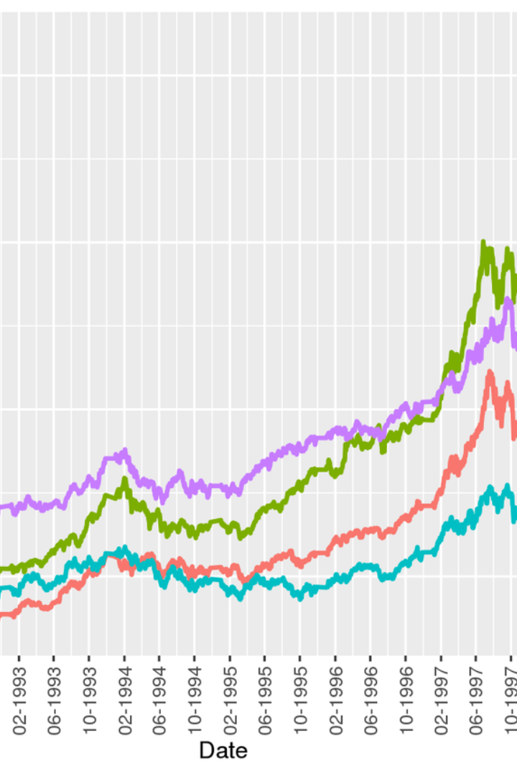
What is pandas?
pandas is an open-source data analysis and manipulation tool, built on top of the Python programming language. It offers data structures and operations for manipulating numerical tables and time series, making it a quintessential tool for data science and machine learning tasks. Its name derived from the term 'panel data', an econometrics term for datasets that include observations over multiple time periods for the same individuals.
With pandas, users have the power to read data from various file formats such as CSV, Excel, and databases, and to perform a vast array of data operations including filtering, aggregating, and merging datasets. The versatility of pandas stems from its DataFrame object, which is a powerful and flexible tabular data structure with labeled axes (rows and columns). Users appreciate pandas for its high-level abstraction, which simplifies complex data manipulation tasks, making them more accessible.
The library's robust feature set and ease of use have cemented its status as a cornerstone in the data science community. Whether it's sorting and reshaping large datasets, merging multiple data sources, or conducting sophisticated statistical analysis, pandas acts as a bridge between the raw data and the insights professionals seek to extract from it. Aided by rich documentation and a supportive community, pandas continues to evolve, constantly integrating new functionalities to adapt to the ever-changing landscape of data analytics.

Slide 8
Key Features of pandas
Data Structures
Data Wrangling
At its core, pandas provides two primary data structures: the DataFrame and the Series. The DataFrame is a two-dimensional, size-mutable, and potentially heterogeneous tabular data structure with labeled axes (rows and columns). It is remarkably versatile and can be thought of as a spreadsheet that can be manipulated through programming. On the other hand, the Series is a one-dimensional ndarray with axis labels, ideal for handling time series data. These structures make data manipulation more intuitive by allowing for high-level abstractions centered around real-world data analysis workflows.
pandas excels in cleaning, transforming, and analyzing data. Its powerful handling of missing data, ability to replace, fill, or drop NA values, and methods for data filtering, conversion, and grouping (like pivot tables in Excel) are unparalleled. pandas provides a plethora of functions for efficiently combining datasets through various join, merge, or concatenate operations, making it an indispensable tool for data wrangling in data science and other analytical fields where combining multiple, disjointed data sources is the norm.
Time Series Analysis
Performance and Efficiency
One of pandas' standout features is its comprehensive set of tools for working with date and time data. Whether it's generating date ranges, converting timestamps, or handling periods and time deltas, pandas simplifies the process. It's particularly valued in fields that heavily rely on time series data, like finance and meteorology, by providing functionality for resampling, frequency conversion, moving window statistics, and date shifting. This makes it straightforward to conduct complex time-based analyses, a task that is otherwise complex and error-prone.
pandas is built on top of the NumPy library, making it extremely fast and efficient for certain types of data operations. Its Cython-based operations enhance performance, particularly for large datasets. Furthermore, pandas' support for categorical data types provides significant memory savings and increased performance for operations involving text data. Ever-increasing efficiency in pandas operations ensures that large datasets are more manageable, reinforcing its position as a vital asset for data analysts and scientists.

Slide 9
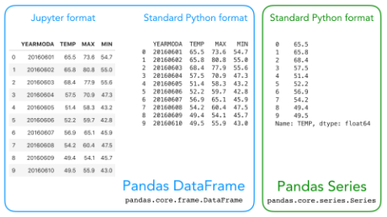
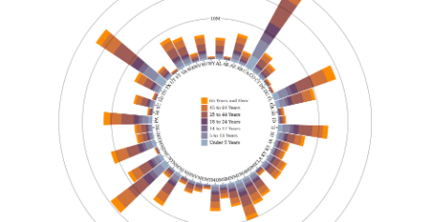
Data Structures in Pandas: Series and DataFrame
Series: The One-Dimensional Powerhouse
DataFrame: The Multi-Dimensional Maestro
Pandas Series is the most basic data structure provided by the Pandas library. It represents a one-dimensional array of data, capable of holding any data type. Key to its utility, each value in a Series comes with an index, which can be thought of as a label, giving names to rows of data, thus making locating data points straightforward and intuitive.
When you embrace the DataFrame, you delve into the real heart of Pandas. DataFrames expand upon the concept of Series to two or more dimensions, resembling a table where each column is a Pandas Series. This is Pandas' most significant tool, permitting intricate operations like joining, merging, and reshaping data, transporting you from raw data to meaningful insights.
The Series data structure doesn't just confine you to numerical data; it seamlessly encompasses strings, datetime objects, and even more complex objects. Its simplicity in structure makes it the perfect candidate for handling time-series data or any dataset indexed uniquely. This simplicity, however, belies the power of operations that Pandas allows, such as data alignment based on index labels, making it a strong foundation of any data manipulation task.
Imagine an Excel spreadsheet or a SQL table where manipulation and transformation of data are done with ease and efficiency—that's a DataFrame. It's where multidimensional datasets come to life, allowing for labeling of rows and columns, missing data handling, and data aggregation. It is the ideal data structure for handling real-life data, which is often tabular and composite, ranging from financial reports to scientific measurements and beyond.

Slide 10

Reading and Writing Data with pandas
1
Importing Data
The journey into data analysis often begins with the importing of data into a pandas DataFrame. Utilizing pandas' extensive set of I/O API functions, a user can easily read from various data sources like CSV, Excel, SQL databases, or JSON files. For instance, using pd.read_csv('file.csv') reads a CSV file and converts it into a DataFrame, which is a powerful, tabular data structure that closely resembles an Excel spreadsheet. By reading data efficiently and accurately, researchers can spend less time on data-entry and more on valuable data exploration and analysis.
Pandas also provides parameters to handle different kinds of data nuances, such as missing values, data types, and date parsing. This preemptive data tidying within the import phase can save substantial time in the data cleaning process, and allows for a smoother transition to the analysis phase.
2
Data Manipulation
Once the data is loaded into a DataFrame, the real power of pandas can be utilized to clean, transform, and manipulate the data. Techniques such as indexing (loc, iloc), filtering, and the application of functions (apply, map) can refine the dataset. Aggregation functions like groupby or pivot tables provide high-level summaries and insightful analyses with minimal coding effort. This functionality not only makes the DataFrame a dynamic tool for handling data but enables users to prepare datasets in a format that aids in the report generation or drives machine learning models.
Pandas' method chaining feature allows multiple operations to be combined into a single line, making code concise and readable. This elegant syntax furthers the efficiency by reducing the complexity of data manipulation tasks.
3
Exporting Data
After conducting in-depth analysis and reaching valuable insights, the data often needs to be shared or used in different applications. Pandas easily exports DataFrames to a variety of formats, allowing analysts to disseminate results in the most convenient and accessible manner for their stakeholders. Functions like df.to_csv('file.csv') or df.to_excel('file.xlsx') encapsulate the comprehensive data handling capabilities of pandas by write-back functions, serving the other end of the data exchange pipeline.
These export options not only include common file types but also allow for direct integration with databases and even cloud storage services. The user can customize file formatting, include indexes, or exclude unwanted data on export, tailor-fitting the output for its intended purpose or audience. This flexibility ensures that insights generated through pandas are captured effectively and can be utilized to the maximum extent.

Slide 11




Data Manipulation and Cleaning with Pandas
Reading and Understanding Data
Cleaning and Preprocessing
Analysis and Transformation
The first step in any data manipulation process is to import the data. Pandas provides an easy-to-use function, read_csv(), that helps us read comma-separated values (CSV) files into a DataFrame. Once the data is loaded, it's crucial to understand it by using methods like head(), which displays the first few rows, and info(), which provides a concise summary of the DataFrame. Mastering these viewing functions will give you insight into the variables, data types, and missing values you might be dealing with.
Cleaning data with pandas involves addressing missing values, duplicates, and erroneous data entries. Depending on the context, missing values can be handled with methods like dropna() to remove or fillna() to replace them. Additionally, use drop_duplicates() to remove duplicate entries that could skew your analysis.
Once your data is clean, pandas shines in data transformation and analysis. Methods like groupby() are vital for aggregating data for analysis, while merge(), join(), and concat() functions are indispensable for combining multiple datasets into a coherent whole. The ability to pivot data easily with pivot() or stack() methods allows for flexible reshaping of your dataset into the required format for your specific research question or analysis.
Data type conversions are often necessary because pandas may not always detect the correct format. The astype() method can cast column data types to the appropriate format, such as converting a column to a categorical type to save memory or to conduct proper analysis. For text data, string manipulation functions available through the str accessor can help normalize and tidy up textual data.
For more advanced manipulation, pandas offer functionalities for time series data processing and the capability to apply custom functions via apply() or vectorized operations with numpy library integration. With pandas, you can seamlessly transition from raw, messy data to insightful analysis and visual representation using the power of Python's data science stack.
Another essential aspect is to examine the descriptive statistics using describe(), which can reveal outliers or anomalies that could indicate data entry errors or other inconsistencies. Understanding the shape and content of your dataset is the foundation upon which all later cleaning and manipulation tasks are built.

Slide 12
Filtering and Sorting Data in Pandas
Data analysis often begins with the crucial steps of filtering and sorting the data to focus on the relevant information for your objectives. In pandas, these processes are intuitive yet powerful, enabling analysts to meticulously refine their datasets for better insights.
Filtering is the act of selecting a subsection of your data based on certain criteria, while sorting is the process of arranging data in a specified order. These operations are foundational for subsequent data analysis and visualization tasks in Python's pandas library.
1
Define Criteria
Start by articulating the conditions that data must meet.
2
Apply Filters
Use pandas methods to select data matching your criteria.
3
Sort Values
Order your data in ascending or descending order.
Analyze & Visualize
4
Proceed to examine and graph your curated dataset.
Within pandas, a range of filtering options allows you to find exact matches, patterns, or ranges of data. Sorting can be done on index labels or data values and can handle multiple levels, providing a multi-dimensional perspective on your dataset. Coding these operations requires specific commands that are both simple to learn and versatile in application.
Rich details such as the use of boolean masks for complex filtering or the intricacies of sorting by index versus sorting by values showcase the robust capabilities of pandas. By mastering these details, analysts can power through large datasets with ease, bringing the most pertinent information to the fore.

Slide 13
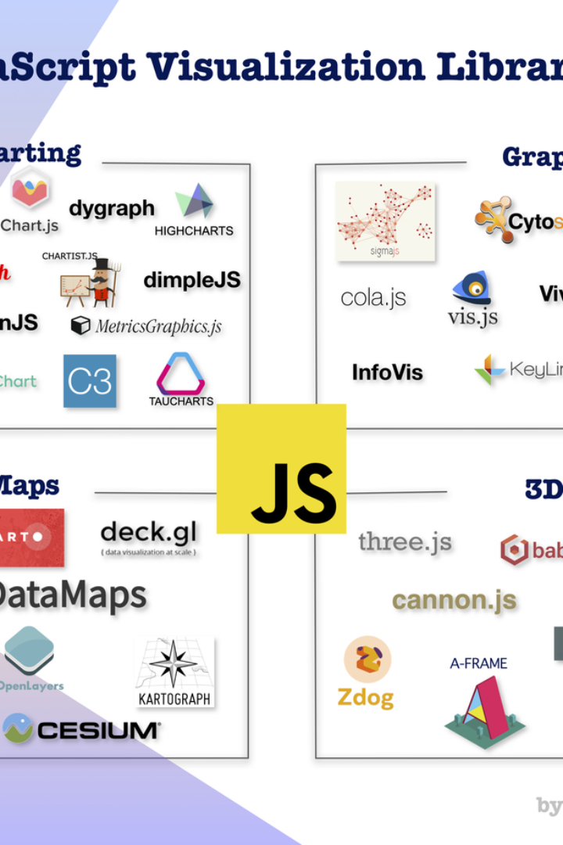
What is Matplotlib?
In the vast landscape of data visualization tools, Matplotlib emerges as a cornerstone within the Python programming environment. It is a robust library that has become the de facto plotting library for many developers and data scientists. Born out of the need for a scientific plotting package that could rival those available in other software environments, Matplotlib was developed to provide a powerful yet user-friendly approach to creating a wide array of graphs and charts.
Through Matplotlib, users gain the flexibility to generate high-quality line plots, scatter plots, bar charts, histograms, and much more. Its design is so versatile that it can work seamlessly with NumPy arrays, a compatibility that fuels its fit within the scientific computing ecosystem. Whether the task at hand is a quick examination of data trends or the creation of publication-quality figures, Matplotlib stands ready to deliver. It's this level of utility and integration that underscores why learning Matplotlib is essential for anyone delving into data analysis with Python.
Not only is it the foundation upon which many other plotting libraries are built—such as Seaborn and Pandas plotting—it also allows for customization that can match nearly any requirement or aesthetic preference. This capability to tailor the look and feel of visuals down to the finest detail ensures that Matplotlib's relevance extends across disciplines, from academia to industry.

Slide 14
Key Features of Matplotlib
High Customizability
Wide Array of Plot Types
Matplotlib stands as a quintessential plotting library for Python programmers, offering an extraordinary level of customization for creating static, interactive, and animated visualizations in Python. Users have control over every aspect of a figure, from line styles, font properties, and color palettes to the overall layout and rendering process. This flexibility empowers analysts and researchers to tailor their plots to precise specifications, ensuring that the visual communication of data is both clear and aesthetically pleasing.
One of the most compelling features of Matplotlib is its extensive variety of plot types. Whether it's simple line charts, histograms, scatter plots, or more complex three-dimensional plots, Matplotlib serves as a multipurpose tool that can handle nearly any type of data visualization. This versatility makes it a go-to choice not just for straightforward data analysis tasks but also for sophisticated scientific visualizations, catering to a broad audience from beginners to advanced users in the research community.
Strong Community Support
Integration with Pandas and NumPy
The thriving community surrounding Matplotlib is both a testament to its utility and a boon to users seeking assistance. Abundant resources ranging from detailed documentation, tutorials, forums, and Q&A sites provide valuable support for both common and unusual use cases. Regular updates and contributions from a diverse set of developers ensure that Matplotlib stays relevant and powerful, adapting to new challenges in the evolving landscape of data science.
Matplotlib seamlessly integrates with other essential Python libraries like Pandas and NumPy, creating a streamlined workflow for data manipulation and visualization. NumPy's computational capabilities, coupled with Pandas’ data structuring proficiency, form a potent trio with Matplotlib's plotting functions. This harmonious interaction enables analysts to process, analyze, and visualize their data all within the same environment, streamlining the data science process and fostering a more efficient analysis pipeline.

Slide 15
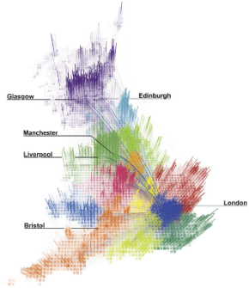
Creating Basic Plots with Matplotlib
Introduction to Matplotlib
Plot Types in Matplotlib
Customizing Plots
Starting with basic plot types, one can create line charts to observe trends over time, bar charts for categorical comparison, and histograms to visualize frequency distributions. For a more nuanced look at data, scatter plots illustrate the relationship between two variables.
For those looking to refine their plots further, Matplotlib provides a wealth of customization options. Annotations can be added to highlight specific data points, while a palette of colormaps is at the user's disposal to distinguish data series.
Matplotlib is a versatile plotting library for Python, widely used for its capability to create a wide array of static, animated, and interactive visualizations. It is particularly beloved for its compatibility with NumPy and pandas, enabling data scientists to seamlessly visualize data from arrays and dataframes.
Interactivity can also be incorporated into plots, such as zooming and panning capabilities. The key to effective data visualization lies in the details, and Matplotlib offers the tools necessary to fine-tune those details to perfection.
Pie charts can highlight parts of a whole for categorical data, and box plots are excellent for observing the distribution and identifying outliers. Mastery of these fundamental plot types is the first step in effectively communicating data insights.
Recognizing the importance of effective data representation, matplotlib allows for detailed customization of plots. Users can adjust colors, shapes, axes, and many other elements to craft a plot that not only conveys the data clearly but also engages the viewer.

Slide 16
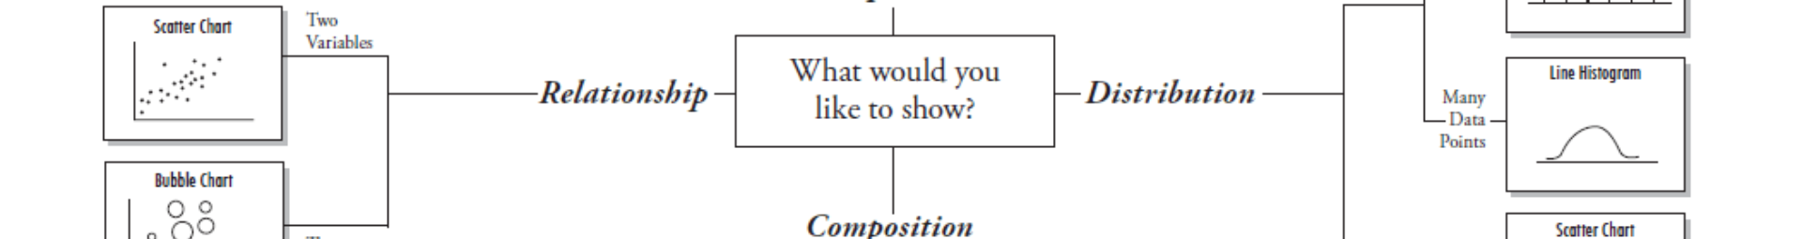
Customizing Plots with matplotlib
Enhancing Visual Appeal
Accessibility Considerations
Conveying the Right Message
One of the primary reasons for customizing matplotlib plots is to enhance their visual appeal. Aesthetic enhancements not only make the data more engaging to the audience, but they can also aid in the interpretability of complex datasets. By tweaking elements such as colors, fonts, and line widths, you can draw attention to key parts of the plot and make your graphs memorable. Selecting the right color palette, for instance, can vastly improve the readability and can be made culturally sensitive when sharing across diverse audiences.
Customization also plays a critical role in making plots accessible to all viewers, including those with color vision deficiencies. matplotlib allows you to customize color schemes to be colorblind friendly, ensuring that the visualizations are inclusive. Additionally, adjusting font size, type, and chart labels can render plots more readable for individuals with visual impairments. This thoughtful customization fosters a broader understanding of the visualized data, regardless of the audience's visual capabilities.
Every plot tells a story, and with matplotlib, you can tailor that story to your audience. Through customization, you can emphasize certain data points, trends, or relationships that are most relevant to your analysis. Annotations, highlights, and custom legends allow you to guide your audience through the data narrative, stressing what’s important. Such carefully considered customizations ensure that your message is conveyed accurately and succinctly, leaving no room for misinterpretation.

Slide 17

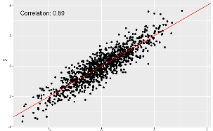

Plotting Multiple Data Sets with Matplotlib
Visual Data Comparison
Detailed Scatter Plots
Effective Use of Histograms
The power of Matplotlib can be best observed when comparing multiple data sets side by side. For instance, visualizing the performance of various financial stocks over time can reveal trends and patterns that numerical data alone might not communicate effectively. A multicolored line chart can distinguish each stock with clarity and lead analysts to meaningful insights.
Matplotlib's versatility shines through in the production of scatter plots that can represent a large number of data points without losing precision. Researchers in fields like epidemiology use scatter plots to identify clusters of data that may indicate underlying relationships between variables like disease incidence and environmental factors.
Uncovering the distribution of a data set is a fundamental step in statistical analysis, and Matplotlib's histograms make this both simple and visually appealing. High-resolution images of histograms can display the frequency of data points within specified ranges, crucial for understanding skewness, outliers, and central tendencies in datasets.
Customization in marker styles, sizes, and colors facilitates the distinction between categories, ensuring each data point's value is communicated efficiently. A well-crafted scatter plot provides insights at a glance, making it a crucial tool for data-intensive inquiries.
Creating histograms that are both informative and aesthetically pleasing involves careful attention to bin size and color gradients. This nuanced approach in Matplotlib ensures histograms are more than just tools; they're also a compelling narrative of the data's story.
Plotting such comparative data in matplotlib involves careful selection of colors and styles to maintain readability and emphasis on key trends, catering to a better analytical framework for decision makers.

Slide 18




Saving and Exporting Plots with Matplotlib
Specification of Path and Format
Customizing Plot Aesthetics
Ensuring Quality and Clarity
Automating Plot Exports
When saving a plot, it's crucial to specify the destination path and file format. Matplotlib allows you to save the figure in a wide range of formats such as PNG, JPEG, SVG, PDF, and more. You can also define the DPI (dots per inch), which controls the resolution of your saved plot. For high-quality publications or presentations, a higher DPI is often preferred to ensure clarity and detail.
Before saving your plot, you might want to customize its aesthetics to match your desired look and feel. Matplotlib provides extensive customization options, including color schemes, font properties, line styles, and markers. Applying these tweaks not only enhances the visual appeal of your plot but also improves readability and the ability to convey information effectively.
Quality is paramount when saving plots. The clarity of text labels, axises, and legends can make a significant difference in how your data is perceived. Take the time to review your plot at the intended export size, adjusting elements accordingly to maintain readability. Remember, a plot that looks clear on your screen might not retain the same quality when printed or embedded into documents.
For projects requiring repetitive plot exports, automation can save time and reduce errors. Matplotlib enables scripting of the save process, which allows for batch exports with consistent formatting. Coupling this with a solid naming convention for your files can streamline the management and retrieval of your visual data assets in larger projects.

Slide 19

The Pinnacle of Data Analysis: Basic Libraries
As we culminate our exploration into the vast terrain of data analysis, it is imperative to acknowledge the monumental role played by foundational libraries such as NumPy, pandas, and matplotlib. These tools are the bedrock upon which the data science community constructs its edifices of insight and inference.
NumPy provides an array and numerical computing framework that is unparalleled in its efficiency, enabling rapid and reliable computation. This becomes the scaffolding for more complex operations, and is particularly essential when dealing with large datasets. It is a supporting beam that, while it may not be visible in the final structure of analysis, is fundamental to its integrity.
In a similar vein, pandas emerges as a versatile and powerful library for data manipulation and analysis. It offers data structures that act as intuitive containers for the diverse forms of data encountered in the wild. Through pandas, we find the ability to cleanse, transform, and enrich data - processes akin to refining raw materials into a form that is both valuable and usable.
Finally, the troves of data that we encounter would be inert without the ability to visualize and communicate our findings; this is where matplotlib shines. It serves as the paintbrush with which analysts can illustrate complex ideas in stunning clarity. The creation of graphs, charts, and plots translates abstract data points into a narrative that can be grasped by all, regardless of their familiarity with the underlying numbers.

Slide 20
Resources for Learning More About NumPy, pandas, and Matplotlib
For those eager to delve further into the world of data analysis and visualization in Python, there are extensive resources available to master libraries like NumPy, pandas, and matplotlib. NumPy is a fundamental package for scientific computing in Python, providing powerful array objects and a range of operations to perform calculations on these arrays. A good starting point is the official documentation, which is both comprehensive and well-organized for beginners and advanced users alike.
pandas is renowned for its ability to handle and manipulate large datasets, especially for data cleaning and preparation. It works seamlessly with data structures such as Series and DataFrame. Those new to pandas will find a wealth of tutorials and user guides online, many of which include real-world examples and hands-on exercises to reinforce learning. Don't overlook community resources such as Stack Overflow and GitHub for code snippets and project examples, as well as published books specializing in pandas for deep dives into more complex uses of the library.
Visualizing Your Data With matplotlib
When it comes to visualizing data, matplotlib is the go-to library. It offers an array of plotting functions for a variety of graph types, including histograms, bar charts, and scatter plots. For beginners, the matplotlib gallery is an excellent place to get inspired and to see code samples in action. Moreover, the multitude of customization options can feel overwhelming, but with dedicated practice and exploration of available styles and themes, you can create stunning visual narratives of your data.
To further enhance your learning experience, engaging with interactive platforms such as Jupyter Notebooks can be extremely beneficial. These platforms allow you to see the output of your code as you go, making it easier to understand the effects of your commands and to troubleshoot when necessary. Additionally, participating in coding forums and attending workshops or webinars can provide valuable insights and networking opportunities with experts in the field. With these resources at your fingertips, the journey into data science with NumPy, pandas, and matplotlib will be both rewarding and illuminating.

